Slide 1
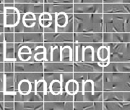

Deep Learning London @deeplearningldn | #deeplearningldn Dirk Gorissen @elazungu | Ali Sayed @AaaLee

Slide 2


Slide 3
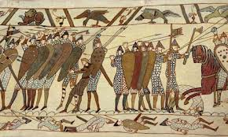

Slide 4

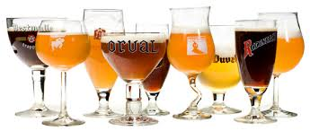
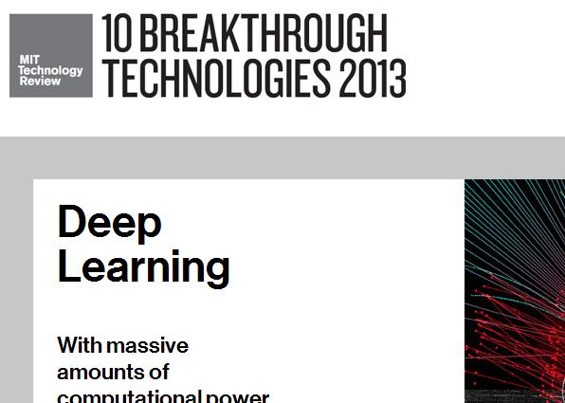
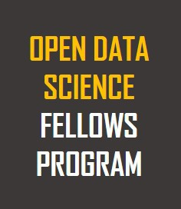
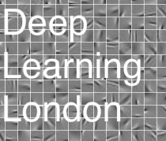

Slide 5
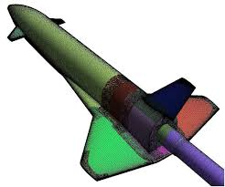
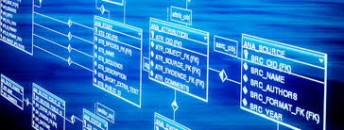
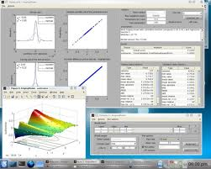
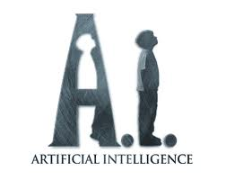



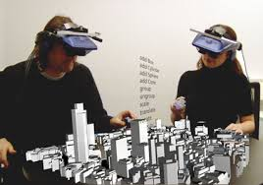

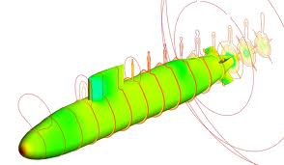
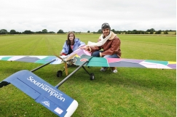
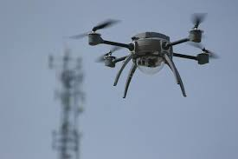
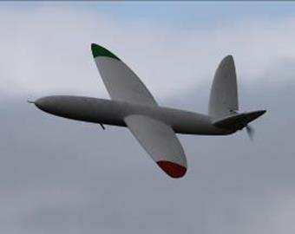
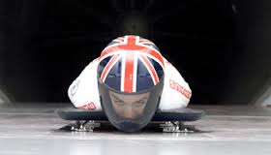
Dirk?
WWW.RSE.AC.UK

Slide 6

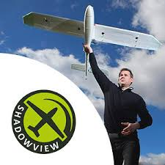


Slide 7
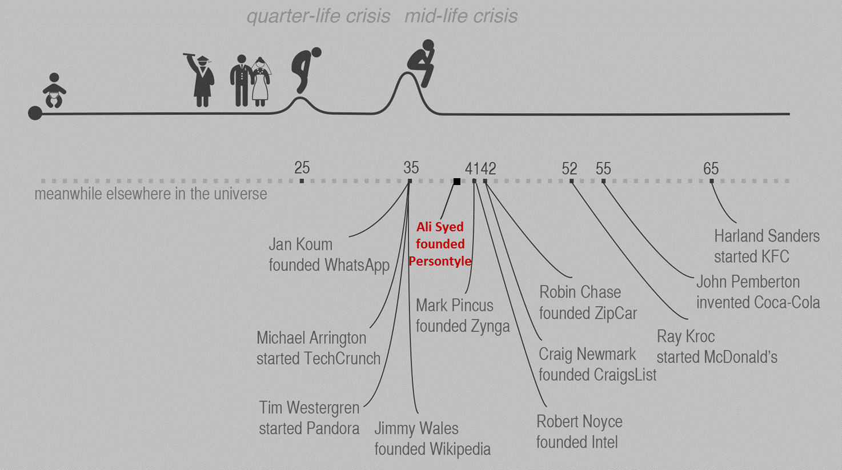
ALI SYED
Founder @Persontyle
Data Science ∩ Social Change
Interested in people, outliers, meaning, life, coffee, and machine learning

Slide 8
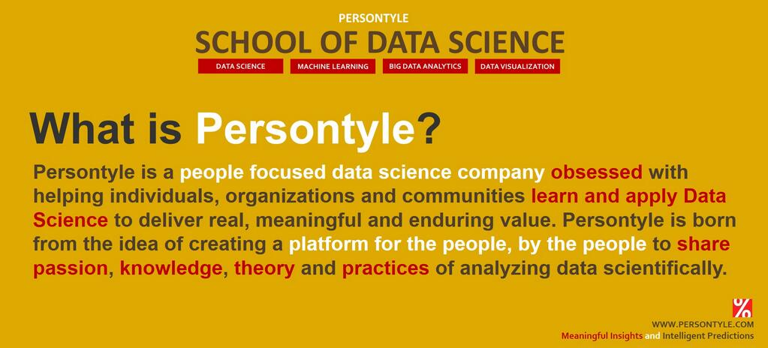

Slide 9
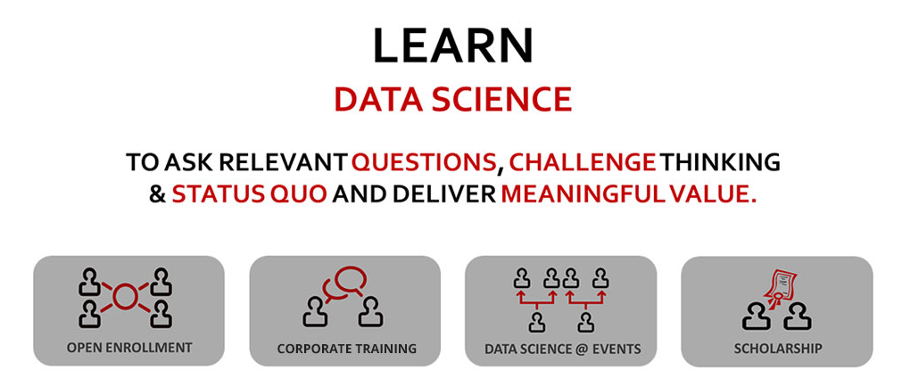

Slide 11
Meetup Scope
Focus on deep methods for machine learning
Theory, applications, critique, …
Complimentary to other meetups
Not just artificial neural networks!
deep GP, deep SVM, belief nets, …
Format
Talks, workshops, hackathons, …

Slide 12
What is this not?

Slide 13
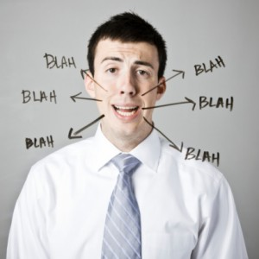
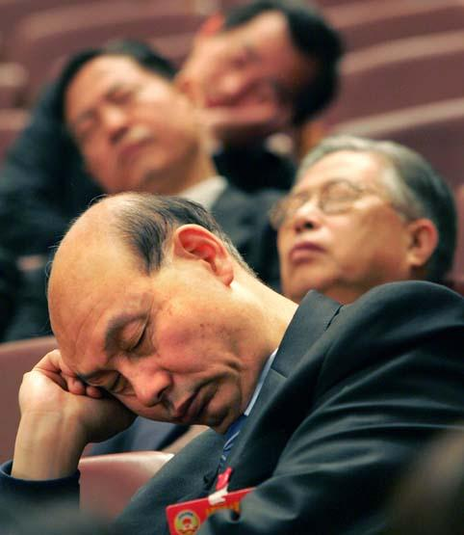
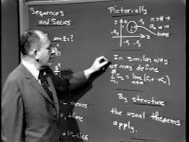
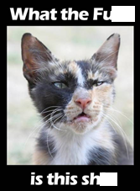

Slide 14
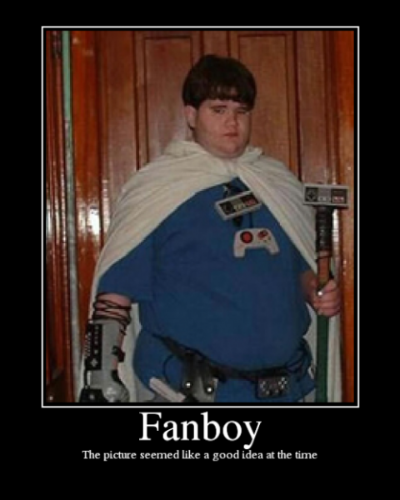

Slide 15
Upcoming
Piotr (Bing)
Turoial on Autoencoders
Jeff Hawkins (Numenta / Grok)
Cortical Learning
Boumediene Hamzi (Imperial)
Elements of Machine Learning and Learning Theory with Application to Artificial Neural Networks
Andreas Damianou (Sheffield U)
Deep GP
Subati (Numenta)
Numenta Platform for Intelligent Computing and Cortical Learning Algorithm
…

Slide 16


Slide 17

@elazungu | #bigoldn

Slide 18

@elazungu | #bigoldn

Slide 19

Dirk Gorissen - @elazungu | Ali Sayed - @AaaLee

